Slide 1
A Brief Intro to Deep Learning
Tong He
Simon Fraser University

Slide 2
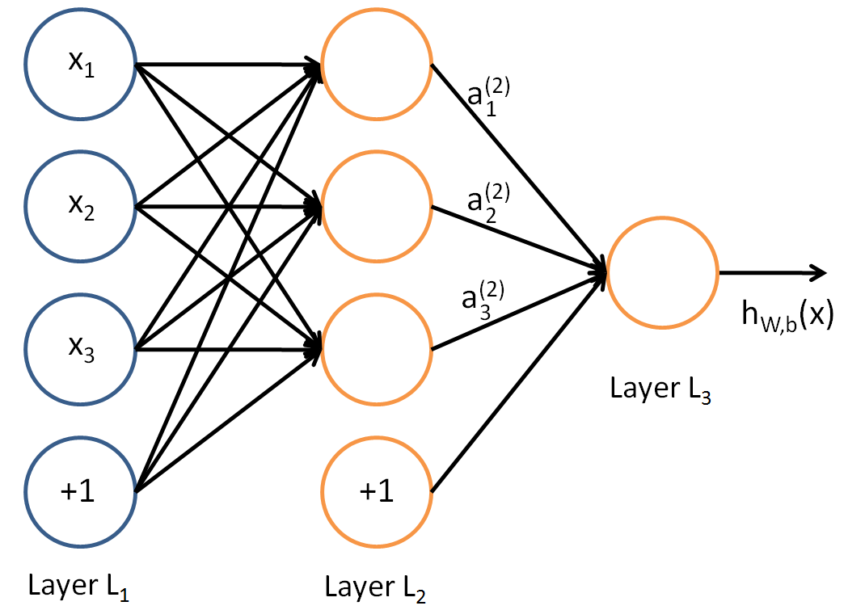
What is Deep Learning?
A family of machine learning models
Mainly neural networks
We only introduce a basic version
Getting popular for the extraordinary achievements

Slide 3
Extraordinary Achievements
Image Understanding
Self-Driving Car
AlphaGo

Slide 4
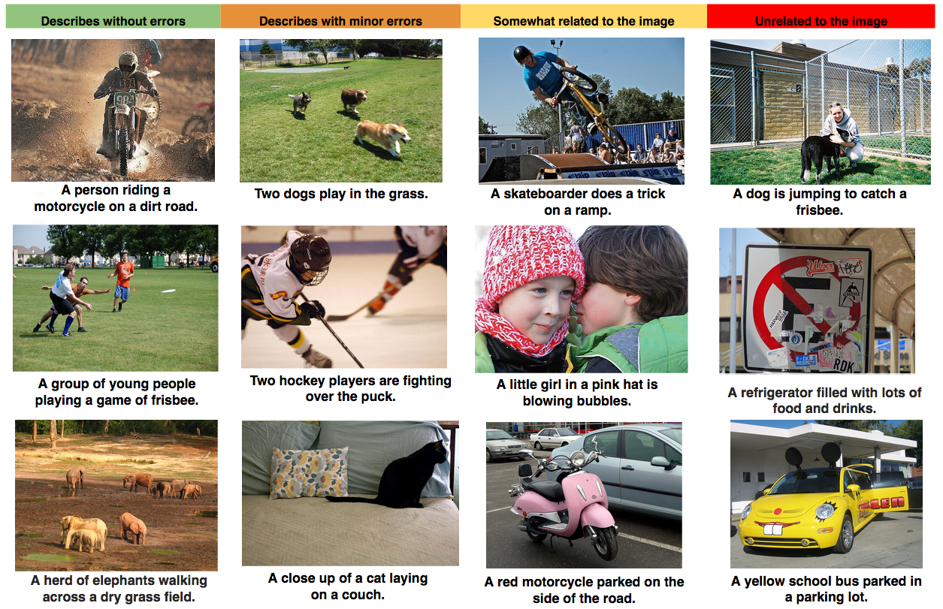
Image Understanding
Describe an image with a sentence

Slide 5
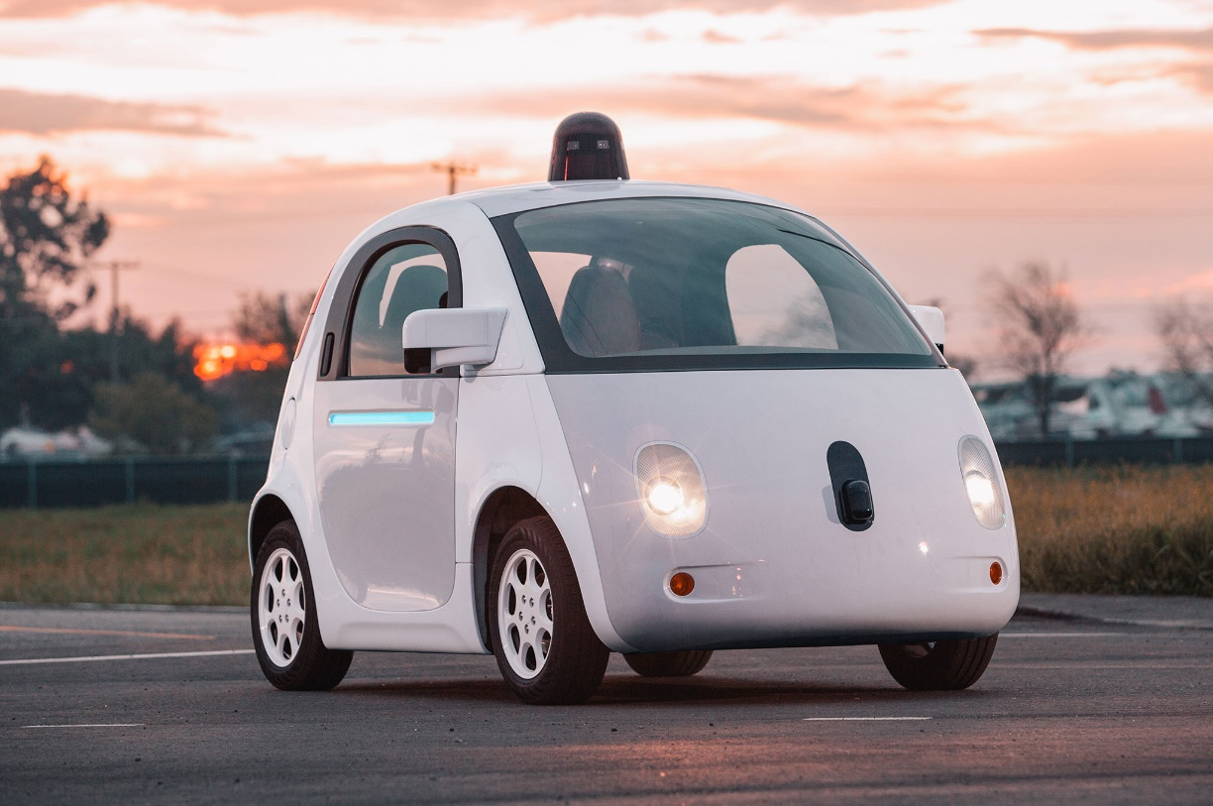
Self-Driving Car
Environment Recognition
Traffic Signals
Cars/Pedestrians
Cross road
Real-time decision
Car operation

Slide 6
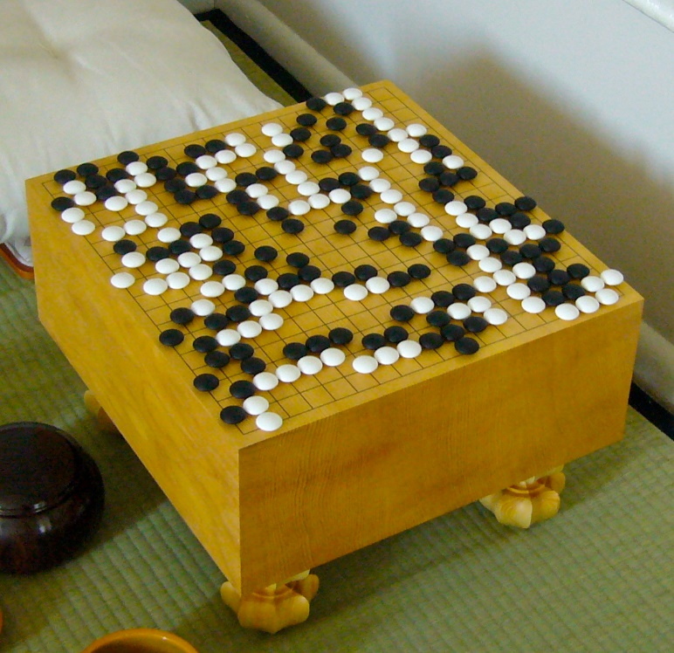
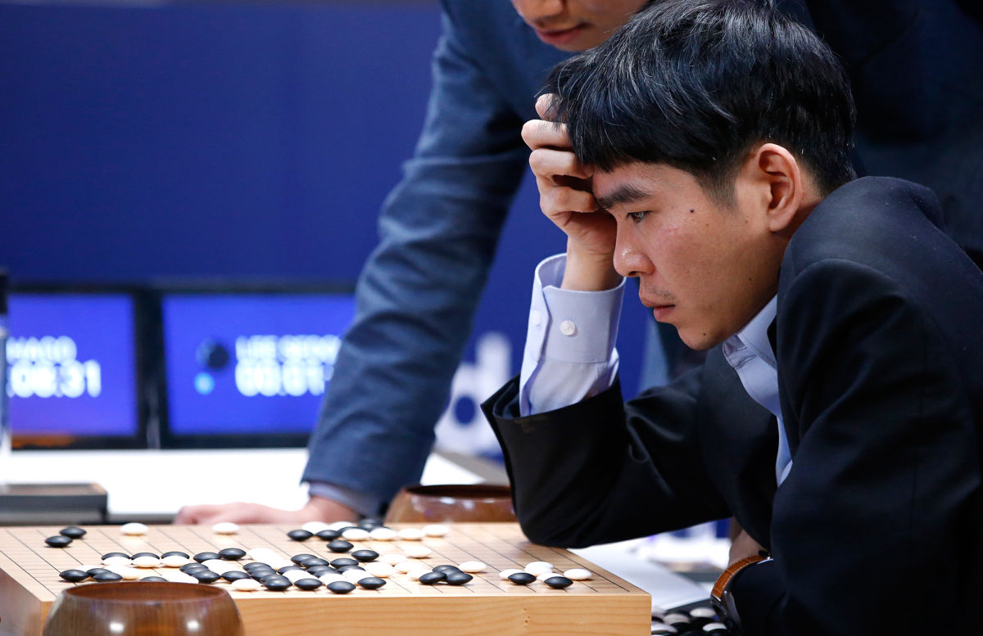
AlphaGo
The game of Go
AlphaGo vs Lee Sedol

Slide 7

A simple shallow learning model
w
A neural network
One hidden layer
Input → hidden layer → output
Projection: $a_{j}=f(\sum{w_{ij}x_{i}})$
It holds between layers

Slide 8
Intuition
Hidden layer: an description
Capture the non-linear patterns
The output layer make better prediction
With a higher level of “understanding”

Slide 9
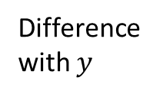

Training: Backpropagation
Prediction Error
How far are we from being perfect
Modify hidden → output
Take a step towards perfection
Modify input → hidden
Take another step towards perfection
$$\hat{y}$$
Difference with $y$
modification
modification

Slide 10
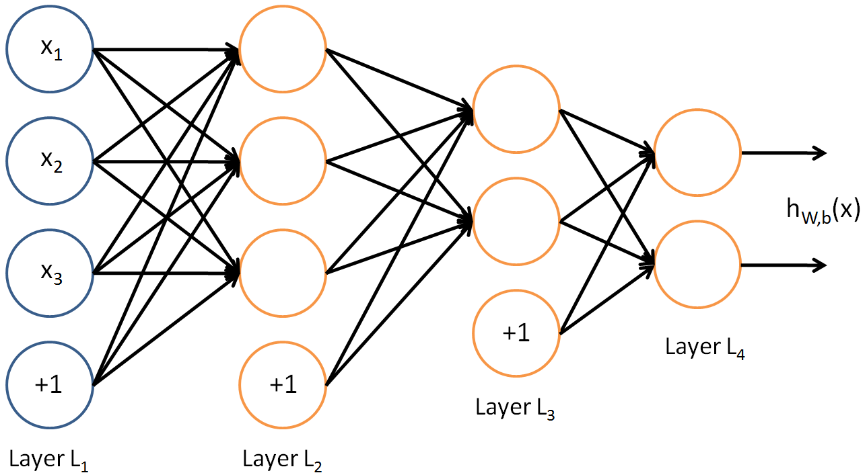
A deep learning model
A neural network
add multiple hidden layers?
Input → hidden layer → … → hidden layer → output
“Houston, we have a problem”

Slide 11
Difficulties
Not enough data
Local optima
Diffusion of gradients

Slide 12
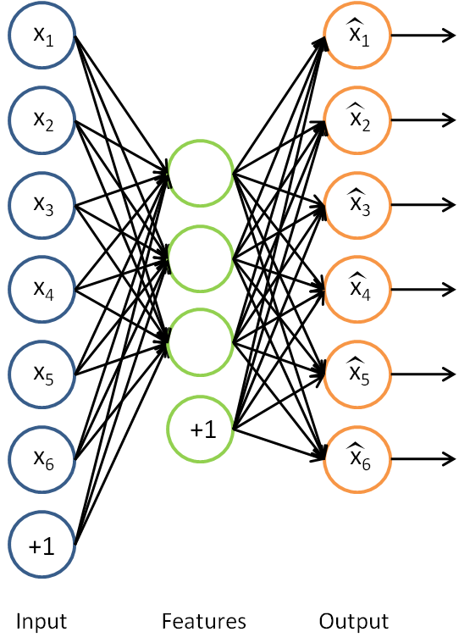
Autoencoder
Care more about the abstraction first
A neural network to predict the input
Recover input from the hidden layer
High quality features

Slide 13
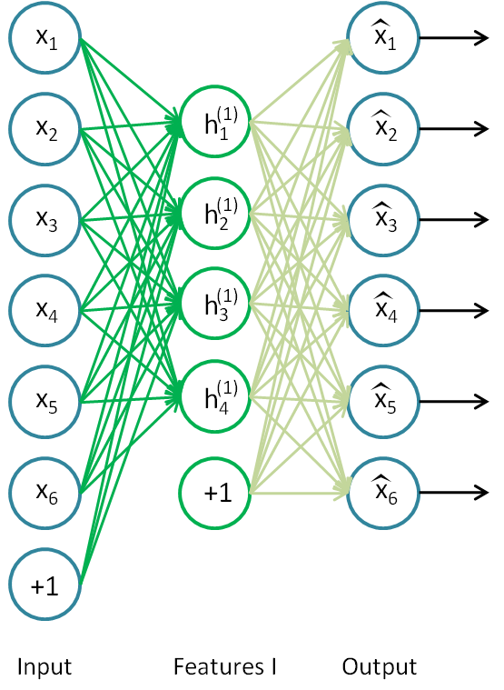
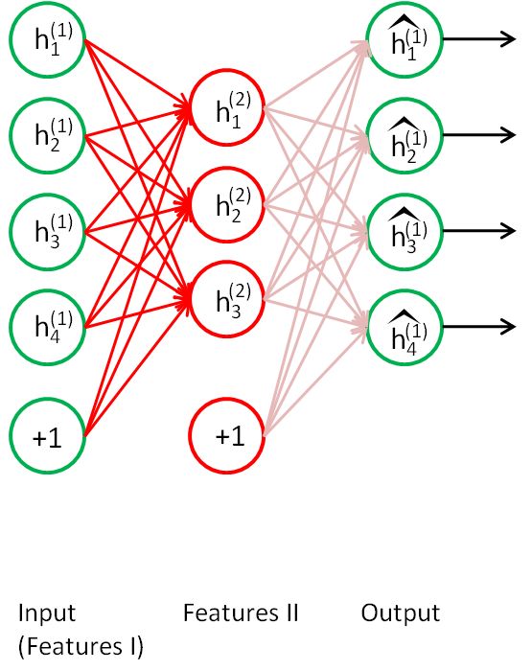
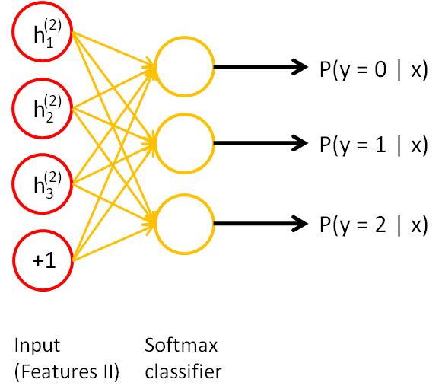
Stacked Autoencoder

Slide 14
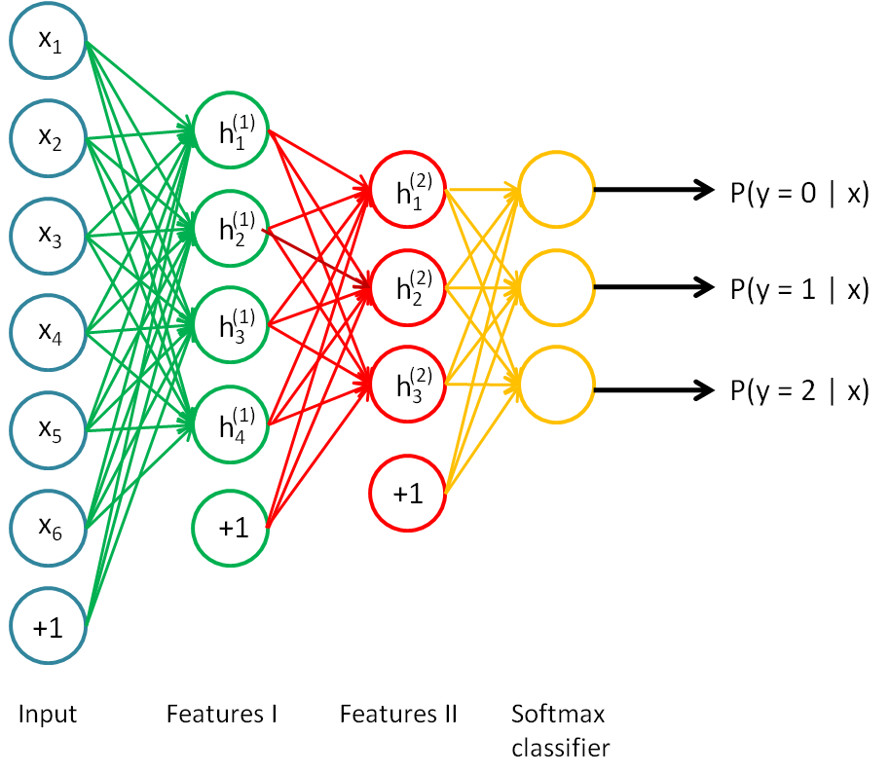
Stacked Autoencoder
Use the last hidden layer as input
Fine tune at the last step

Slide 15
Stacked Autoencoder
Use the last hidden layer as input
Get higher abstraction
No need to have labeled data
Avoid training entirely at first
Avoid diffusion of gradients
Pre-train → Fine-tune
Find better local optima

Slide 16
Other families
CNN
RNN
LSTM

Slide 17
R packages
MXNet: https://github.com/dmlc/mxnet
H2O: http://www.h2o.ai/

Slide 18
Resources
UFLDL: Unsupervised Feature Learning and Deep Learning
Deeplearning.net
Research papers

Slide 19
Q&A

